Slide 1

Intermediate Git and GitHub
Northwestern IT Research Computing Services

Slide 2
Git Branches
Commits are snapshots of the files in a repository with some metadata
Including reference(s) to parent commit(s)
Branches in Git are just named pointers to commits.
master is not special, it’s just the default branch.
HEAD is a special pointer to the most recent commit on the current branch.

Slide 3
Branching Example

Slide 4
Exercise 1
Create a new folder and initialize a git repository inside it (git init)
Create a file and commit it.
Create and check out a new branch (git branch <name>; git checkout <name>)
Create another file and commit it.
Check out the master branch and merge your other branch into it (git merge <name>)
View commit history (git log --oneline)

Slide 5
Exercise 2
Create and check out a new branch called conflict.
Add 4 lines of text to one of your files and commit.
Check out the master branch, edit the same file, add 4 different lines of text and commit.
Try to merge the conflict branch.
Work out the merge conflict and commit.
View commit log (git log --oneline --graph)
How many parent commits does each commit have?
Delete conflict branch and view log again. What changed?

Slide 6
Using Branches
Don’t commit to master except in very simple projects.
Some projects use long-running “develop” or per-developer branches.
Use per-feature or per-issue branches.

Slide 7
Remotes
A “remote” is a reference to another git repository.
When a repository is cloned, a remote named origin is created by default.

Slide 8
Remotes
“Tracking branches” are references to the state of branches on a remote and are managed for you. E.g. origin/master
git fetch <remote> gets updates from the remote repository.

Slide 9
Remotes
Commits from a remote are not merged in automatically!
You still need to merge them into your local branches with git merge.
(or use git pull which does fetch + merge)

Slide 10
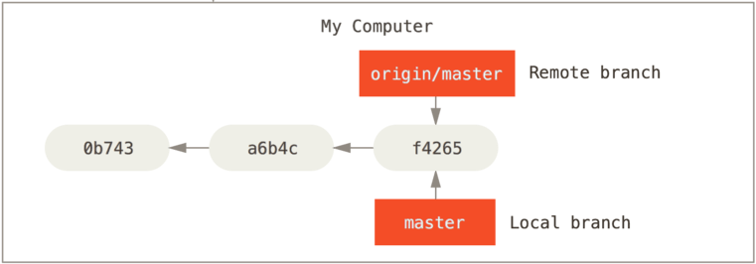
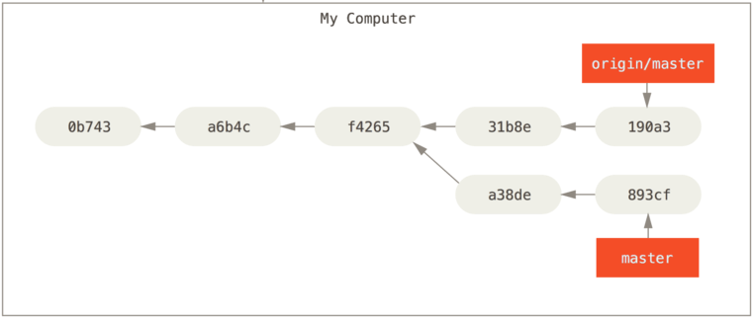
Remote vs. Local Branches

Slide 11
Remote-related commands
git fetch <remote> # gets updates
git merge <remote>/<branch>
git pull <remote> <branch> # fetch + merge
git push <remote> <branch>
git checkout --track <remote>/<branch>

Slide 12
Exercise 3
Create a new repository with a README in GitHub.
Clone the repository locally.
In GitHub, edit the README file and save (commit).
Use git fetch to get the new commit. Did your local copy of README change? What is the output of git log and git log --remotes?
Merge in the new commit.
On your computer, edit README again, commit, and push to GitHub.

